Slide 1
Business Analytics and Data Science Applications
Burnout Project - BurnApp
Giuseppe Baccaro | Victor Faessler | Alex Marchese | Rebekka Heikkilae | Matias Santesso

Slide 2



There were a number of ways we considered to use data analytics in order to solve managerial issues.
Profitability Focus
Finding ways to increase revenue or decrease costs. Predict revenue per customer or best-selling products
Use data analytics to solve a managerial issue
Customer Focus
Use data to make the customer the center of the business. Predict ways to improve customer experience
Employee Focus
Use data to predict salaries, improve HR recruitment or manage the health

Slide 3
We opted for the employee focus as all of us are soon to be employees
Profitability Focus
Finding ways to increase revenue or decrease costs. Predict revenue per customer or best-selling products
Use data analytics to solve a managerial issue
Customer Focus
Use data to make the customer the center of the business. Predict ways to improve customer experience
Employee Focus
Use data to predict salaries, improve HR recruitment or manage the health

Slide 4



Risk of burnout is an increasingly relevant topic which needs to be addressed by managers
Employee Focus
Use data to predict salaries, improve HR recruitment or manage the health
Stress at the workplace is an increasingly relevant topic
Risk of burnout makes employees more prone to error, poor work performance, mental health issues and conflict in the workplace.
40% of employees cite burnout as a reason for leaving their job
18% of employees feel stressed daily at their job
Risks of burnout makes employees more prone to error, poor work performance, mental health issues, and conflict in the workplace

Slide 5
Risk of burnout is an increasingly relevant topic which needs to be addressed by managers
Employee Focus
Use data to predict salaries, improve HR recruitment or manage the health
Create an App which can determine the burnout score as well as give recommendations of how to lower the burnout score based important health-related factors affecting the employee
Stress at the workplace is an increasingly relevant topic
Risk of burnout makes employees more prone to error, poor work performance, mental health issues and conflict in the workplace.
40% of employees cite burnout as a reason for leaving their job
18% of employees feel stressed daily at their job
Risks of burnout makes employees more prone to error, poor work performance, mental health issues, and conflict in the workplace

Slide 6




We had to choose and adjust our dataset set to fit all managers
Choosing and working with the right dataset
There are only very few burnout-related datasets
We chose a Mendeley Data looking at the burnout risk among Dutch General Practitioners
It was based on burnout-related survey questions with an ordinal scale
It had a lot of features compared to other datasets.
The dataset had to be adjusted to fit all managers and not just doctors
“I feel that I treat some patients too impersonal”
“Does your work require your constant attention?”

Slide 7




A number of actions had to be taken in order to predict burnout and its most influential factors
Predictive Analysis: Determine the employee burnout score and the factors which most affect it
Imputing the missing values into the dataset
Transforming the scale of burnout from an ordinal to a binary one
Use various methods to determine how much the features influence burnout and which are the most important ones
Qualitatively and quantitively decide the most relevant features to keep

Slide 8
A number of models were used to explain the burnout dependent variable
I feel "burned out" by my work (Ordinal Scale)
I feel "burned out" by my work (Binary Scale)
Never
Sporadic
Occasionally
Yes
Regularly
Often
Very Often
Always
No
Cluster Analysis
Linear Regression
Logistic Regression
Tree Regression
Random Forest Regression
XGBoost Regression
Using Burnout on an ordinal scale
Using Burnout on a binary scale
Using summary variables

Slide 9
The Random Forest Regression was the best performing model in explaining burnout
Cluster Analysis
Linear Regression
Logistic Regression
Tree Regression
Random Forest Regression
XGBoost Regression
Using Burnout on an ordinal scale
R2: 83.6%
R2: 95.7%
R2: 91.5%
Using Burnout on a binary scale
Clustering Score:
80%
Singular Matrix Error
R2: 69.9%
Using summary variables
R2: 62.3%

Slide 10
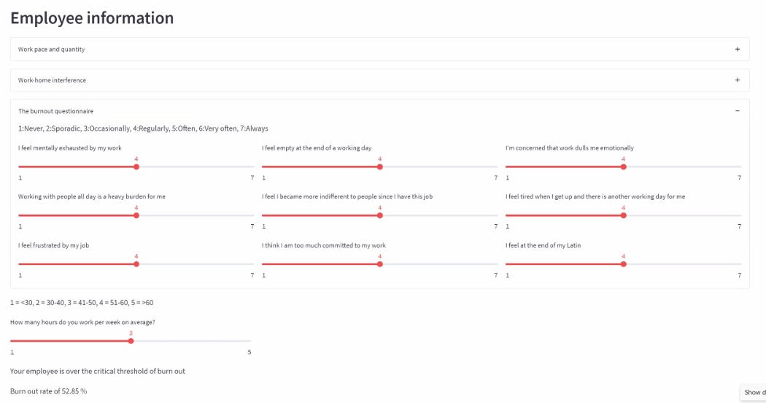
The app shows fours variables which the manager can change in order to have his employees below the burnout risk threshold
Predicting the Burnout Score
We created four categories which could be influenced by the manager
We set burnout threshold at a score of 45%
If the score is above it, action needs to be taken to decrease the burnout score at a healthy level
Workload
The amount of work is excessive
Work Intensity
The workplace is too fast-paced
Social Distance
Image of WEBSITE
Because of his work, the employee is becoming emotionally unavailable
Mental Exhaustion
The work is mentally crushing

Slide 11


Through function minimization, the manager can reduce burnout to either the threshold level or the optimal level of burnout
Preventive Analysis: Give recommendations to managers on how to lower the burnout score
Large changes to the four categories to have healthy employees
Reduce Burnout to an optimal level
Reduce Burnout
Reduce Burnout
Reduce Burnout
Small changes the manager can implement to reach the threshold
Reduce Burnout to the threshold

Slide 12



This app allows managers to determine the burnout score of their employees and see how they can reduce it
Employee burnout is one of the most relevant topics in the labour market.
Decrease performance
Decrease motivation
Increase employee turnover
Predict the employee burnout score and whether changes need to be made
Adjust a survey dataset of ordinal answers to all managers
Help managers have healthy employees
Prevent the situation by determining the percentage of workplace changes that need to be made

Slide 13

This app allows managers to determine the burnout score of their employees and see how they can reduce it
Limitations of the App
The dataset was initially centered towards doctors and therefore might not apply correctly to all type of employees
The app gives recommendations on the percentages that needs to be decreased in each major category not concrete solutions
We would have liked to have empirical studies to confirm whether the main factors that our model identified are based academically

